Slide 1
CS F415: Data Mining
Yashvardhan Sharma

Slide 2
Today’s Outline
Introduction
  Data Mining Tasks
  Applications
  Comparisons
Data Preprocessing

Slide 3
Sequential Pattern Discovery
Given is a set of objects, with each object associated with its own timeline of events, find rules that predict strong sequential dependencies among different events.
(A B) (C) (D E)

Slide 4
Sequential Pattern Discovery: Examples
In telecommunications alarm logs,
  (Inverter_Problem Excessive_Line_Current)
  (Rectifier_Alarm) --> (Fire_Alarm)
In point-of-sale transaction sequences,
  Computer Bookstore:
  (Intro_To_Visual_C) (C++_Primer) --> (Perl_for_dummies,Tcl_Tk)
  Athletic Apparel Store:
  (Shoes) (Racket, Racketball) --> (Sports_Jacket)

Slide 5
Regression
Predict a value of a given continuous valued variable based on the values of other variables, assuming a linear or nonlinear model of dependency.
Greatly studied in statistics, neural network fields.
Examples:
  Predicting sales amounts of new product based on advetising expenditure.
  Predicting wind velocities as a function of temperature, humidity, air pressure, etc.
  Time series prediction of stock market indices.

Slide 6
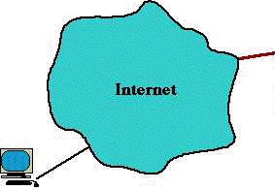
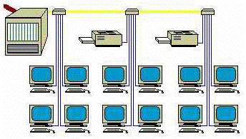
Deviation/Anomaly Detection
Detect significant deviations from normal behavior
Applications:
  Credit Card Fraud Detection
  Network Intrusion
  Detection
Typical network traffic at University level may reach over 100 million connections per day

Slide 7
Data Mining vs. Statistical Analysis
Statistical Analysis:
Ill-suited for Nominal and Structured Data Types
Completely data driven - incorporation of domain knowledge not possible
Interpretation of results is difficult and daunting
Requires expert user guidance
Data Mining:
Large Data sets
Efficiency of Algorithms is important
Scalability of Algorithms is important
Real World Data
Lots of Missing Values
Pre-existing data - not user generated
Data not static - prone to updates
Efficient methods for data retrieval available for use

Slide 8
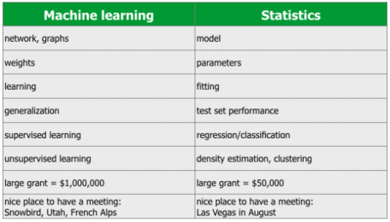

Slide 9
Data Mining vs. DBMS
Example DBMS Reports
  Last months sales for each service type
  Sales per service grouped by customer sex or age bracket
  List of customers who lapsed their policy
Questions answered using Data Mining
  What characteristics do customers that lapse their policy have in common and how do they differ from customers who renew their policy?
  Which motor insurance policy holders would be potential customers for my House Content Insurance policy?

Slide 10
Data Mining and Data Warehousing
Data Warehouse: a centralized data repository which can be queried for business benefit.
Data Warehousing makes it possible to
  extract archived operational data
  overcome inconsistencies between different legacy data formats
  integrate data throughout an enterprise, regardless of location, format, or communication requirements
  incorporate additional or expert information
OLAP: On-line Analytical Processing
Multi-Dimensional Data Model (Data Cube)
Operations:
  Roll-up
  Drill-down
  Slice and dice
  Rotate

Slide 11
An OLAM Architecture
Mining query
Mining result
Layer4
User Interface
User GUI API
OLAM
Engine
OLAP
Engine
Layer3
OLAP/OLAM
Data Cube API
Layer2
MDDB
MDDB
Meta Data
Filtering&Integration
Database API
Filtering
Layer1
Data Repository
Data cleaning
Data
Warehouse
Databases
Data integration

Slide 12
DBMS, OLAP, and Data Mining
 | DBMS | OLAP | Data Mining
Task | Extraction of detailed and summary data | Summaries, trends and forecasts | Knowledge discovery of hidden patterns and insights
Type of result | Information | Analysis | Insight and Prediction
Method | Deduction (Ask the question, verify with data) | Multidimensional data modeling, Aggregation, Statistics | Induction (Build the model, apply it to new data, get the result)
Example question | Who purchased mutual funds in the last 3 years? | What is the average income of mutual fund buyers by region by year? | Who will buy a mutual fund in the next 6 months and why?

Slide 13
Example of DBMS, OLAP and Data Mining: Weather Data
DBMS:
Day | outlook | temperature | humidity | windy | play
1 | sunny | 85 | 85 | false | no
2 | sunny | 80 | 90 | true | no
3 | overcast | 83 | 86 | false | yes
4 | rainy | 70 | 96 | false | yes
5 | rainy | 68 | 80 | false | yes
6 | rainy | 65 | 70 | true | no
7 | overcast | 64 | 65 | true | yes
8 | sunny | 72 | 95 | false | no
9 | sunny | 69 | 70 | false | yes
10 | rainy | 75 | 80 | false | yes
11 | sunny | 75 | 70 | true | yes
12 | overcast | 72 | 90 | true | yes
13 | overcast | 81 | 75 | false | yes
14 | rainy | 71 | 91 | true | no

Slide 14
Example of DBMS, OLAP and Data Mining: Weather Data
By querying a DBMS containing the above table we may answer questions like:
What was the temperature in the sunny days?
{85, 80, 72, 69, 75}
Which days the humidity was less than 75?
{6, 7, 9, 11}
Which days the temperature was greater than 70?
{1, 2, 3, 8, 10, 11, 12, 13, 14}
Which days the temperature was greater than 70 and the humidity was less than 75?
The intersection of the above two: {11}

Slide 15
Example of DBMS, OLAP and Data Mining: Weather Data
OLAP:
Using OLAP we can create a Multidimensional Model of our data (Data Cube).
For example using the dimensions: time, outlook and play we can create the following model.
9 / 5 | sunny | rainy | overcast
Week 1 | 0 / 2 | 2 / 1 | 2 / 0
Week 2 | 2 / 1 | 1 / 1 | 2 / 0

Slide 16
Example of DBMS, OLAP and Data Mining: Weather Data
Data Mining:
Using the ID3 algorithm we can produce the following decision tree:
    outlook = sunny
      humidity = high: no
      humidity = normal: yes
    outlook = overcast: yes
    outlook = rainy
      windy = true: no
      windy = false: yes

Slide 17
Major Issues in Data Warehousing and Mining
Mining methodology and user interaction
  Mining different kinds of knowledge in databases
  Interactive mining of knowledge at multiple levels of abstraction
  Incorporation of background knowledge
  Data mining query languages and ad-hoc data mining
  Expression and visualization of data mining results
  Handling noise and incomplete data
  Pattern evaluation: the interestingness problem
Performance and scalability
  Efficiency and scalability of data mining algorithms
  Parallel, distributed and incremental mining methods

Slide 18
Major Issues in Data Warehousing and Mining
Issues relating to the diversity of data types
  Handling relational and complex types of data
  Mining information from heterogeneous databases and global information systems (WWW)
Issues related to applications and social impacts
  Application of discovered knowledge
    Domain-specific data mining tools
    Intelligent query answering
    Process control and decision making
  Integration of the discovered knowledge with existing knowledge: A knowledge fusion problem
  Protection of data security, integrity, and privacy

Slide 19
What is Data?
Collection of data objects and their attributes
An attribute is a property or characteristic of an object
  Examples: eye color of a person, temperature, etc.
  Attribute is also known as variable, field, characteristic, or feature
A collection of attributes describe an object
  Object is also known as record, point, case, sample, entity, or instance
Attributes
Objects

Slide 20
Attribute Values
Attribute values are numbers or symbols assigned to an attribute
Distinction between attributes and attribute values
  Same attribute can be mapped to different attribute values
    Example: height can be measured in feet or meters
  Different attributes can be mapped to the same set of values
    Example: Attribute values for ID and age are integers
    But properties of attribute values can be different
      ID has no limit but age has a maximum and minimum value

Slide 21
Measurement of Length
The way you measure an attribute is somewhat may not match the attributes properties.

Slide 22
Types of Attributes
There are different types of attributes
  Nominal
    Examples: ID numbers, eye color, zip codes
  Ordinal
    Examples: rankings (e.g., taste of potato chips on a scale from 1-10), grades, height in {tall, medium, short}
  Interval
    Examples: calendar dates, temperatures in Celsius or Fahrenheit.
  Ratio
    Examples: temperature in Kelvin, length, time, counts

Slide 23
Properties of Attribute Values
The type of an attribute depends on which of the following properties it possesses:
  Distinctness: = ≠
  Order: < >
  Addition: + -
  Multiplication: * /
  Nominal attribute: distinctness
  Ordinal attribute: distinctness & order
  Interval attribute: distinctness, order & addition
  Ratio attribute: all 4 properties

Slide 24
Attribute Type
Description
Examples
Operations
Nominal
The values of a nominal attribute are just different names, i.e., nominal attributes provide only enough information to distinguish one object from another. (=, ≠)
zip codes, employee ID numbers, eye color, sex: {male, female}
mode, entropy, contingency correlation, χ² test
Ordinal
The values of an ordinal attribute provide enough information to order objects. (<, >)
hardness of minerals, {good, better, best},
grades, street numbers
median, percentiles, rank correlation, run tests, sign tests
Interval
For interval attributes, the differences between values are meaningful, i.e., a unit of measurement exists.
(+, - )
calendar dates, temperature in Celsius or Fahrenheit
mean, standard deviation, Pearson's correlation, t and F tests
Ratio
For ratio variables, both differences and ratios are meaningful. (*, /)
temperature in Kelvin, monetary quantities, counts, age, mass, length, electrical current
geometric mean, harmonic mean, percent variation

Slide 25
Attribute Level
Transformation
Comments
Nominal
Any permutation of values
If all employee ID numbers were reassigned, would it make any difference?
Ordinal
An order preserving change of values, i.e.,
new_value = f(old_value)
where f is a monotonic function.
An attribute encompassing the notion of good, better best can be represented equally well by the values {1, 2, 3} or by { 0.5, 1, 10}.
Interval
new_value =a * old_value + b where a and b are constants
Thus, the Fahrenheit and Celsius temperature scales differ in terms of where their zero value is and the size of a unit (degree).
Ratio
new_value = a * old_value
Length can be measured in meters or feet.

Slide 26
Discrete and Continuous Attributes
Discrete Attribute
  Has only a finite or countably infinite set of values
  Examples: zip codes, counts, or the set of words in a collection of documents
  Often represented as integer variables.
  Note: binary attributes are a special case of discrete attributes
Continuous Attribute
  Has real numbers as attribute values
  Examples: temperature, height, or weight.
  Practically, real values can only be measured and represented using a finite number of digits.
  Continuous attributes are typically represented as floating-point variables.

Slide 27
Types of data sets
Record
  Data Matrix
  Document Data
  Transaction Data
Graph
  World Wide Web
  Molecular Structures
Ordered
  Spatial Data
  Temporal Data
  Sequential Data
  Genetic Sequence Data

Slide 28
Important Characteristics of Structured Data
  Dimensionality
    Curse of Dimensionality
  Sparsity
    Only presence counts
  Resolution
    Patterns depend on the scale

Slide 29
Record Data
Data that consists of a collection of records, each of which consists of a fixed set of attributes

Slide 30
Data Matrix
If data objects have the same fixed set of numeric attributes, then the data objects can be thought of as points in a multi-dimensional space, where each dimension represents a distinct attribute
Such data set can be represented by an m by n matrix, where there are m rows, one for each object, and n columns, one for each attribute

Slide 31
Document Data
Each document becomes a `term' vector,
  each term is a component (attribute) of the vector,
  the value of each component is the number of times the corresponding term occurs in the document.

Slide 32
Transaction Data
A special type of record data, where
  each record (transaction) involves a set of items.
  For example, consider a grocery store. The set of products purchased by a customer during one shopping trip constitute a transaction, while the individual products that were purchased are the items.

Slide 33
Graph Data
Examples: Generic graph and HTML Links

Slide 34
Chemical Data
Benzene Molecule: C₆H₆

Slide 35
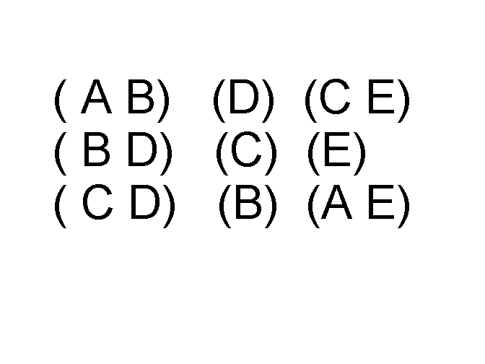
Ordered Data
Sequences of transactions
Items/Events
An element of the sequence

Slide 36
Ordered Data
Genomic sequence data

Slide 37
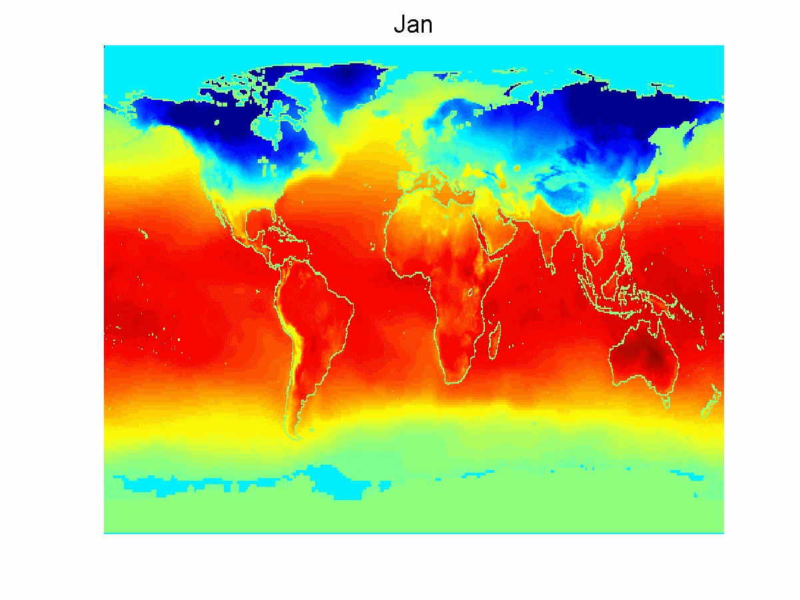
Ordered Data
Spatio-Temporal Data
Average Monthly Temperature of land and ocean

Slide 38
Why Data Preprocessing?
Data in the real world is dirty
  incomplete: lacking attribute values, lacking certain attributes of interest, or containing only aggregate data
  noisy: containing errors or outliers
  inconsistent: containing discrepancies in codes or names
No quality data, no quality mining results!
  Quality decisions must be based on quality data
  Data warehouse needs consistent integration of quality data
  Required for both OLAP and Data Mining!

Slide 39
Why can Data be Incomplete?
Attributes of interest are not available (e.g., customer information for sales transaction data)
Data were not considered important at the time of transactions, so they were not recorded!
Data not recorder because of misunderstanding or malfunctions
Data may have been recorded and later deleted!
Missing/unknown values for some data

Slide 40
Why can Data be Noisy/Inconsistent?
Faulty instruments for data collection
Human or computer errors
Errors in data transmission
Technology limitations (e.g., sensor data come at a faster rate than they can be processed)
Inconsistencies in naming conventions or data codes (e.g., 2/5/2002 could be 2 May 2002 or 5 Feb 2002)
Duplicate tuples, which were received twice should also be removed

Slide 41
Multi-Dimensional Measure of Data Quality
A well-accepted multidimensional view:
  Accuracy
  Completeness
  Consistency
  Timeliness
  Believability
  Value added
  Interpretability
  Accessibility
Broad categories:
  intrinsic, contextual, representational, and accessibility.

Slide 42
Major Tasks in Data Preprocessing
outliers=exceptions!
Data cleaning
  Fill in missing values, smooth noisy data, identify or remove outliers, and resolve inconsistencies
Data integration
  Integration of multiple databases, data cubes, or files
Data transformation
  Normalization and aggregation
Data reduction
  Obtains reduced representation in volume but produces the same or similar analytical results
Data discretization
  Part of data reduction but with particular importance, especially for numerical data

Slide 43
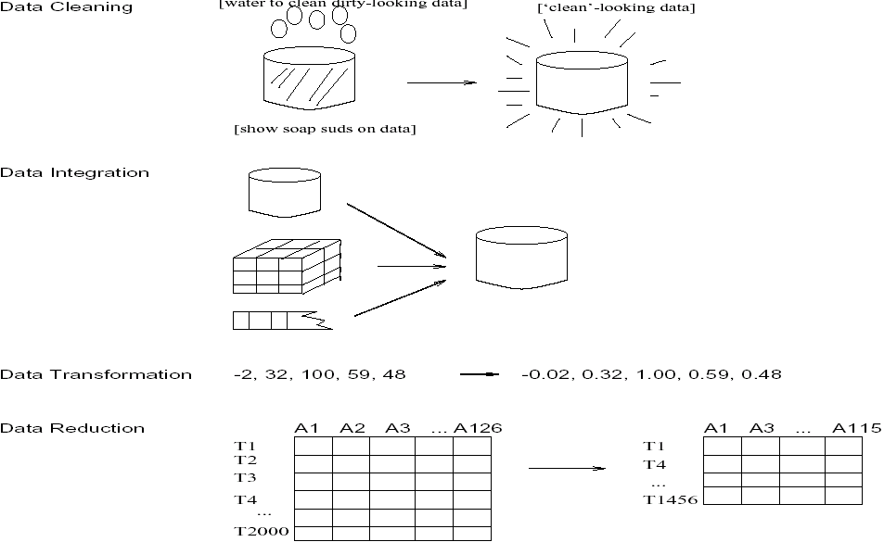
Forms of data preprocessing

